Slide 1
Competitive Programming
11 October 2024

Slide 2
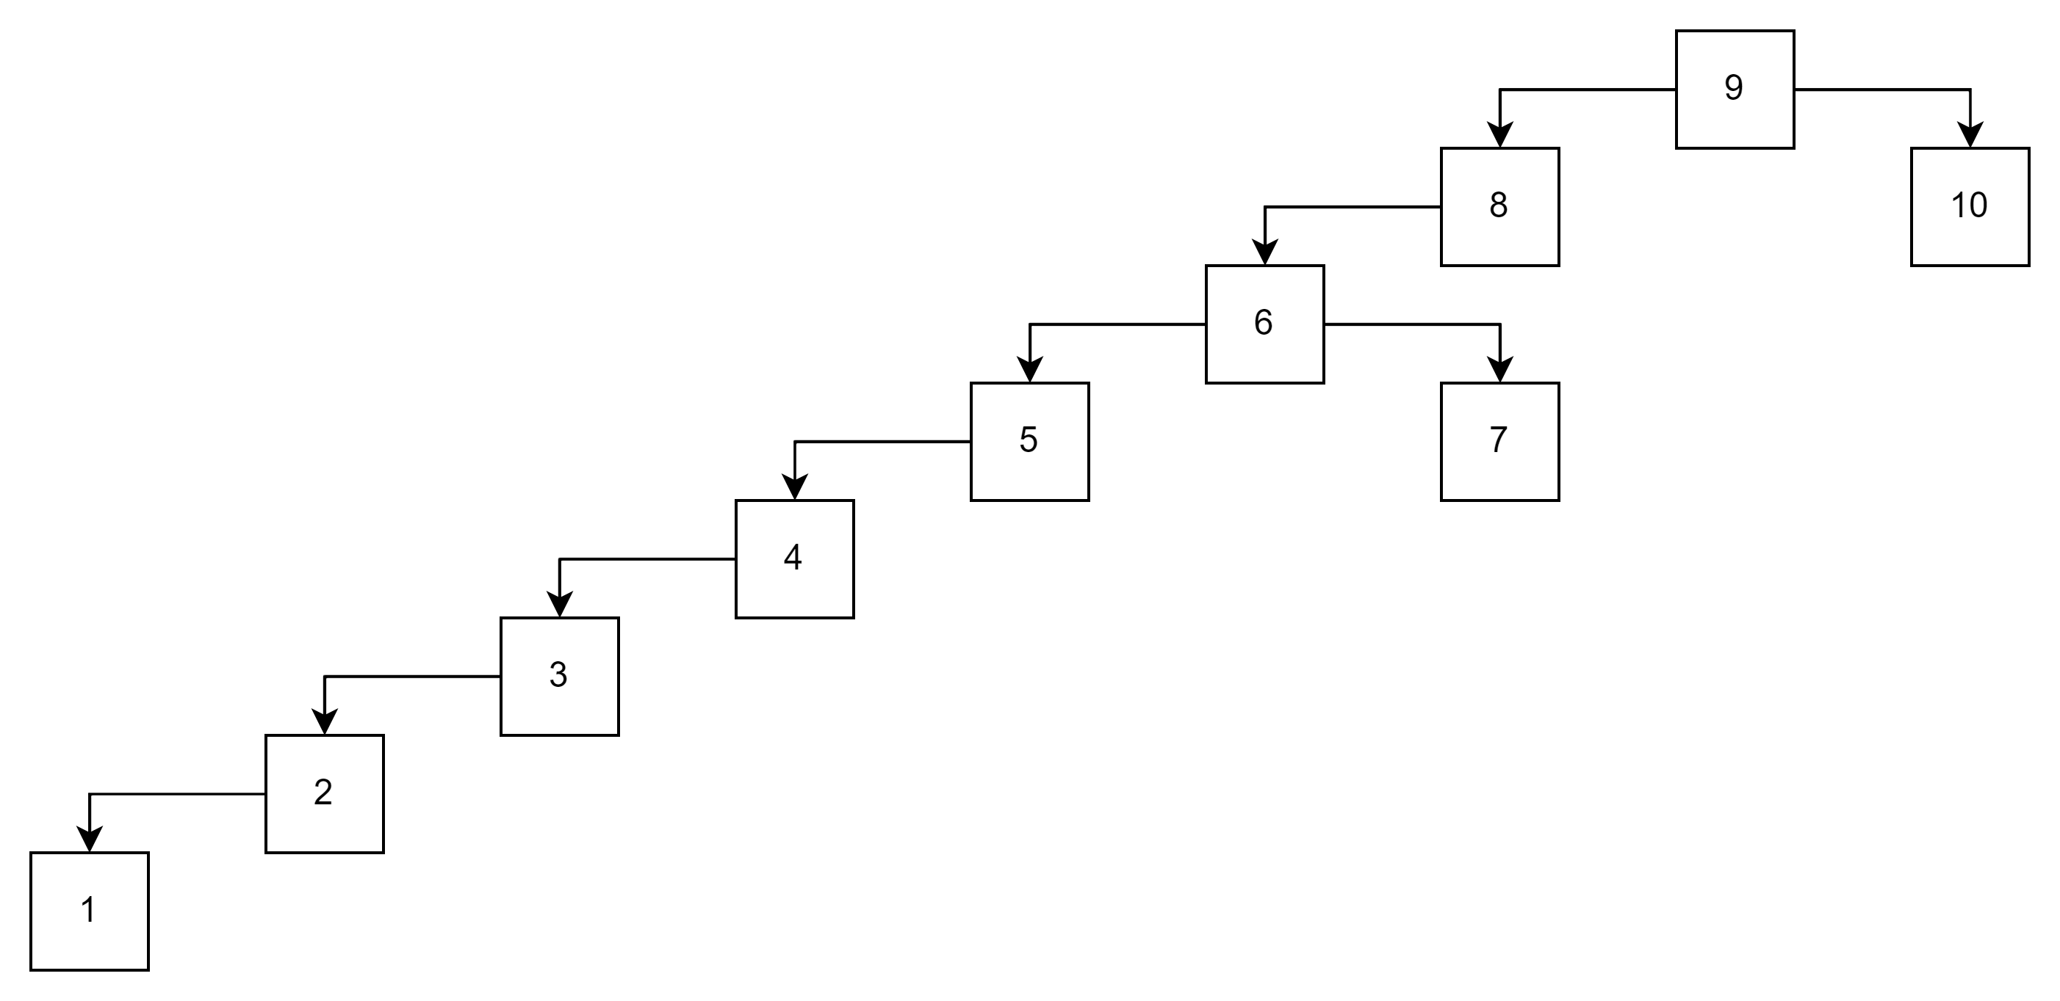
Non-Balanced Binary Tree Problem
In worse case scenario, performance as in case of the linked list.

Slide 3
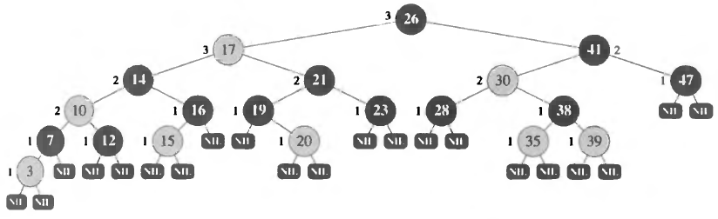
Red-Black Tree
Each node has additional attribute – color.
Root node is always black.
Leaf node (NULL) is always black.
If node is red, then its children are black.
Path from root to leaf cannot be more than twice longer than any other path from root to leaf

Slide 4
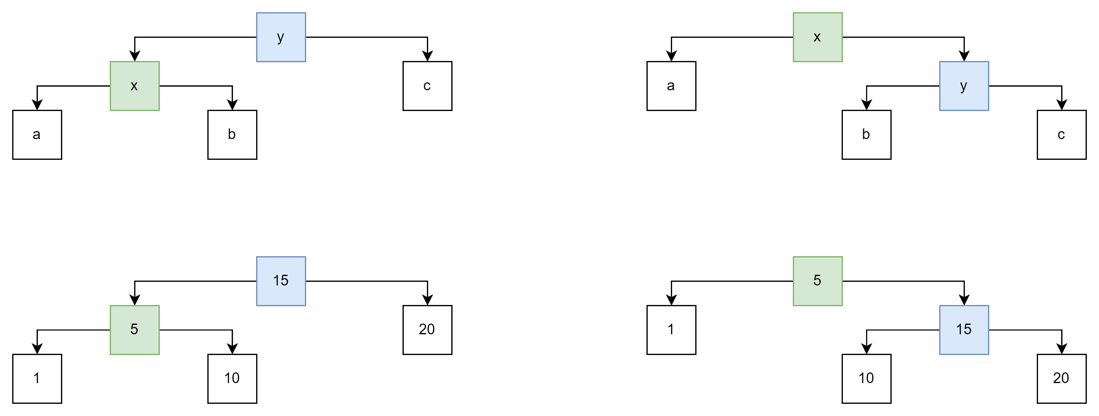
Turn Right and Turn Left - Rotation
Scheme
Example

Slide 5
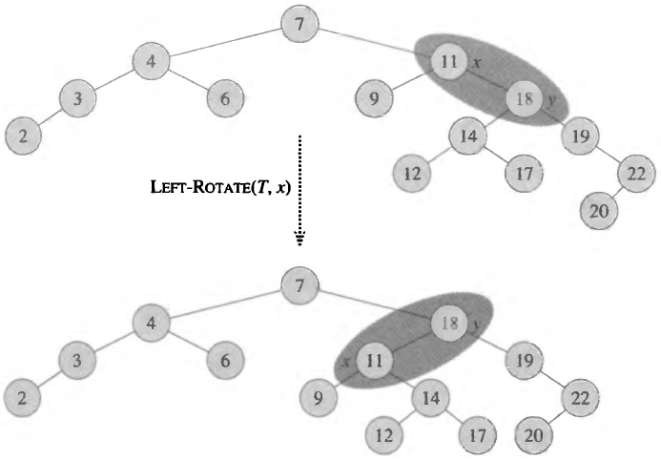
Rotation in the Tree
Example where the tree is rebalanced.

Slide 6
Insertion in Red-Black Tree
Insertion has two parts:
Insertion itself – inserts the node like in non-balanced tree.
When node is inserted, we assign red color to it.
Rebalancing.

Slide 7
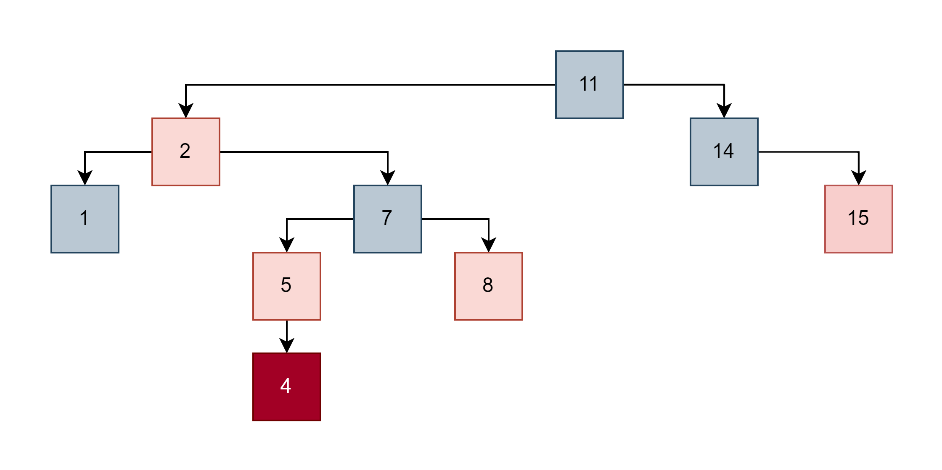
Insertion in Red-Black Tree - Example
Red-Black Tree Properties:
Each node is black or red.
Root is always black.
Leaf (NULL) is always black.
If node is red, then children are black.
For each path from node, the number of black nodes is the same.
Which rule is broken after insertion?

Slide 8
Insertion in Red-Black Tree - Example
Red-Black Tree Properties:
Each node is black or red.
Root is always black.
Leaf (NULL) is always black.
If node is red, then children are black.
For each path from node, the number of black nodes is the same.

Slide 9
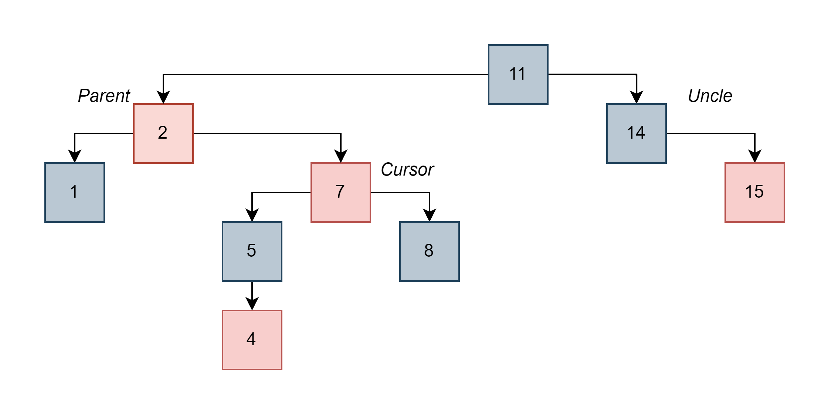
Rebalancing
Change colors to fix the property (5 is black now).
Now (2) and (7) are red – breaking the property again.

Slide 10
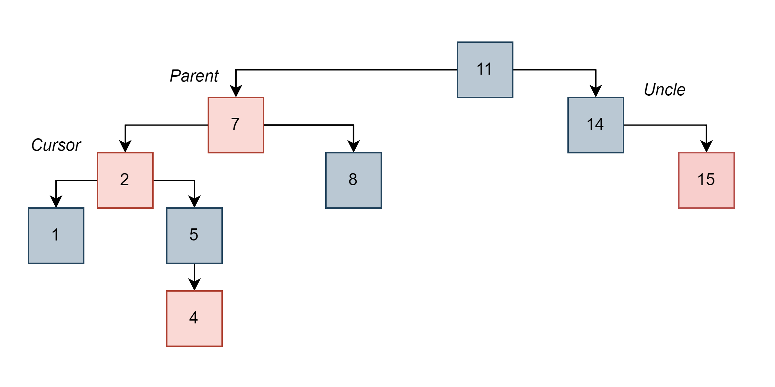
Rebalancing
Change colors will not do anything, we need to perform Left Rotation.
The tree is still breaking the rule.

Slide 11
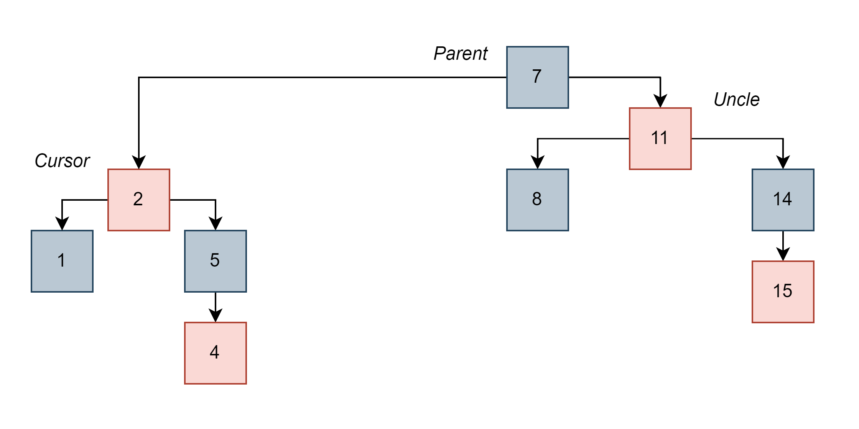
Rebalancing
Need recolor and make Right Rotation.
The tree is balanced now. We stop when parent is NOT red.

Slide 12
Other Binary Balanced Trees
Adelson-Velskii Landis (AVL)

Slide 13
Where Can I Find Binary Balanced Trees
C++:
std::map<K, T> and std::set<K>. Implementation based on Red-Black tree.
Do not confuse with unordered_map<K, T> and unordered_set<K>!
C#:
SortedDictionary<K, V> and SortedSet<K>.
Do not confuse with Dictionary<K, V>!
Python:
No built-in implementation of bBST. collections.OrderedDict is hash based collection!
JavaScript:
No built-in implementation of bBST.

Slide 14
bBST and Hash Table Operations
bBST provides an additional feature – the structure is always sorted. For example, it allows to print out the content in a sorted way O(N).
We did not cover it here, but there are In-Order traverse algorithm that allows to traverse collection in O(N).
Operation | bBST | Hash Table
Insert | O(log(N)) | O(1) average, in worse case O(N)
Remove | O(log(N)) | O(1) average, in worse case O(N)
Search | O(log(N)) | O(1) average, in worse case O(N)

Slide 15
Lets Think about Regular Work
Where do you see possible benefits from using such structures?

